Slide 1
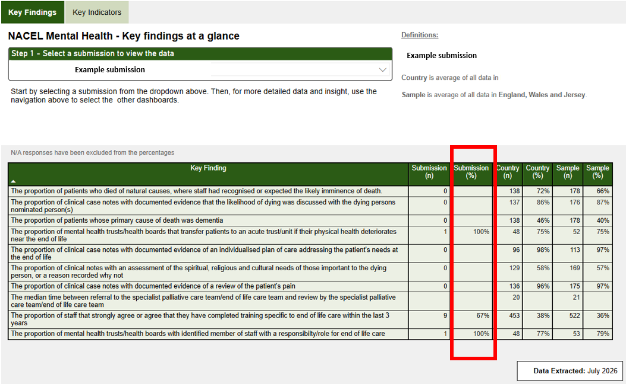
Instructions to create your bespoke infographic
Use the PowerBI dashboard available on the NACEL Data and Improvement Tool.
  Login to the NACEL DIT
  Go to “Dashboards”
  Go to the Dashboard ‘Key Findings’
  Find your organisation’s submission(s) in the dropdown
  Follow instructions on slide 2 to copy your findings into the infographic template on slide 3

Slide 2
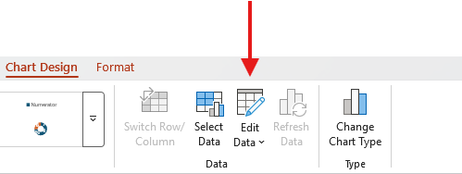
Instructions to create your bespoke infographic
Populate the template
  Insert name of the Trust and the submission
  Populate the “Submission” pie charts by clicking the pie chart and then selecting the option ‘Edit Data’ from the ‘Chart Design’ tab.
  This will open up an Excel data table to populate your submission results.
    Ensure you input both the numerator (your percentage finding) and the non-numerator (100 – your percentage finding = non-numerator). You may be asked to insert your percentages as decimals.
    Example: If your finding is 75% then your non-numerator would be 25%. You would input 0.75 as the numerator and 0.25 as the non-numerator. Double check the chart looks the way it should.
  Manually type your findings result in place of the ‘X’ value for each pie chart.

Slide 3


Key Findings at a Glance
National Audit for Care at the End of Life Mental Health Spotlight 2025
Your submission name
NATIONAL
SUBMISSION
NATIONAL
SUBMISSION
Proportion of patients
who died of natural
causes, where staff had recognised or
expected the likely imminence of death.
Proportion of clinical
case notes with
documented evidence
that the likelihood of dying was discussed with the dying persons
nominated person(s).
66%
X%
87%
X%
Proportion of patients
whose primary cause
of death was dementia.
Proportion of mental health trusts/health
boards that transfer patients to an acute
trust/unit if their physical health deteriorates
near the end of life.
40%
X%
75%
X%
Proportion of clinical
case notes with
documented evidence of an individualised
plan of care addressing the patient’s needs at the end of life.
97%
X%
Proportion of clinical notes with an
assessment of the spiritual, religious and
cultural needs of those important to the dying
person, or a reason recorded why not.
57%
X%
Proportion of clinical
case notes with
documented evidence
of a review of the
patient’s pain.
97%
X%
The median time
between referral to
the specialist palliative
care team /end of life
care team and review
by the specialist
palliative care team/
end of life care team.
21
hours
X%
Proportion of staff that
strongly agree or agree
that they have completed
training specific to end
of life care within the
last 3 years.
36%
X%
Proportion of mental health trusts/health
boards with an identified
member of staff with a responsibility / role for end of life care.
79%
X%
‘National’ refers to the results for acute and community hospitals in England, Wales and Jersey.

